Slide 1



HINDUSTHAN COLLEGE OF ENGINEERING AND TECHNOLOGY Approved by AICTE, New Delhi, Accredited with ‘A’ Grade by NAAC (An Autonomous Institution, Affiliated to Anna University, Chennai) COIMBATORE-32
PROJECT PHASE II
Full Stack Development in Agriculture Field.
(“AgriToy”)
TEAM MEMBERS:
Vibin V 19109062
Vigneshwaran A 19109063
Viswa P 19109067
Ranjithkumar M 19109808
TEAM GUIDE:
Mr. P. KARTHIK M.E
ASSISTANT PROFESSOR

Slide 2
ABSTRACT
The project report has been prepared based on available data, opinions provided by farmers, other provincial agriculture officer and professors. The use of the Web has had many positive effects on education. Teachers and students are now using the Web to access vast amounts of information and resources in the cyberspace. The real life situation can be little different depending on the area of fields, water resources and climates. The project is considered for the Agriculture students and new farmers based on basic ideas, commonly used techniques, new technology's introduces cross field methods, organics fertilizers, etc,.. . The general basic idea of this project to introduce new farming blog writers and readers freely and easily to get more information's abouts traditional and modern Agricultures.

Slide 3
PROPOSED SYSTEM DETAILS
Our project ‘Full Stack Development in Agriculture Field’ to introduce new farming blog writers and readers freely and easily to get more information's abouts traditional and modern Agricultures.
SOFTWARE REQUIREMENT
Visual studio code (for coding).
XAMPP( for database).
FRONT END DEVELOPMENT
HTML, CSS, bootstarp.
BACK END DEVELOPMENT
JavaScript, mysqli/php, java.

Slide 4
METHODOLOGY
Idea
decision
Web
Development
Web
Testing
Web
Hosting
Survey
Idea was decided and survey is taken according to our idea for the applicability.
Designed and simulated in blender for the visual checking.
Then we started web development of the ideology.
We done various test like logging in, signing up, and stability test.
And the page is web hosting.

Slide 5
Future Scope
Agriculture engineering students gain the knowledge from agritoy website it leads to make them own business ideas to became entrepreneur.
To atchive maximum data for cropping ,cultivation, irrigation ,maintenance should be survey from all over india.
Our motive to get the website to most use full for the engineering students and professers to the knowledge about the agriculture field.

Slide 6
LITERATURE SURVEY AND FEASIBILITY STUDY
Manish Mahant, Abhishek Shukla, Sunil Dixit, Dileshwer Patel, (2012) The application of Information and Communication Technology (ICT) in agriculture is increasingly important. E-Agriculture involves the conceptualization, design, development, evaluation and application of innovative ways to use information and communication technologies (ICT) in rural domain, with a primary focus on agriculture. Information and Communication Technology (ICT) can play a significant role in maintaining properties of information as it consists of three main technologies. These technologies are applied for processing, exchanging and managing data, information and knowledge.
2. Ugwuishiwu C.H., Udanor C.N., Ugwuishiwu B.O., (2012) This paper proposes an Agro-Information System that enables a farmer to have relevant information about a crop, such as the varieties and other requirements like soil type, temperature, type and quantity of fertilizer, time of planting, time of maturity, planting distance, diseases, pest, pest and Disease control measures, rainfall, sunshine, etc. of that crop. The level of application of this information determines the volume and efficiency of the crop yield. AIS software is designed and implemented which helps the farmer achieve the afore-mentioned objectives.
3. HavliCek, J. Vanek, V. Lohr, E. Cervenkova, (2010) The rapid advancement in Information and Communications Technologies (ICTs) has given rise to new applications that were impossible just few years ago. Agriculture is an important sector with the majority of the rural population in developing countries depending on it. The sector faces major challenges of enhancing production in a situation of dwindling natural resources necessary for production. ICT plays an important role in challenging and uplifting the livelihoods of the rural populace using an agro computer-based information system. This paper proposes an Agro-Information System that enables a farmer to have relevant information about a crop, such as the varieties and other requirements like soil type, temperature, type and quantity of fertilizer, time of planting, time of maturity, planting distance, diseases, pest, pest and Disease control measures, rainfall, sunshine, etc. of that crop. The level of application of this information determines the volume and efficiency of the crop yield. AIS software is designed and implemented which helps the farmer achieve the afore-mentioned objectives.
4. Sanjeev S Sannakki, Vijay S Rajpurohit, V B Nargund, Arun Kumar R, Prema S Yallur, (2011) Present paper introduces an innovative approach to automatically grade the disease on plant leaves. The system effectively inculcates Information and Communication Technology (ICT) in agriculture and hence contributes to Precision Agriculture. Presently, plant pathologists mainly rely on naked eye prediction and a disease scoring scale to grade the disease. This manual grading is not only time consuming but also not feasible. Hence the paper proposes an image processing based approach to automatically grade the disease spread on plant leaves by employing Fuzzy Logic. The results are proved to be accurate and satisfactory in contrast with manual.grading.

Slide 7
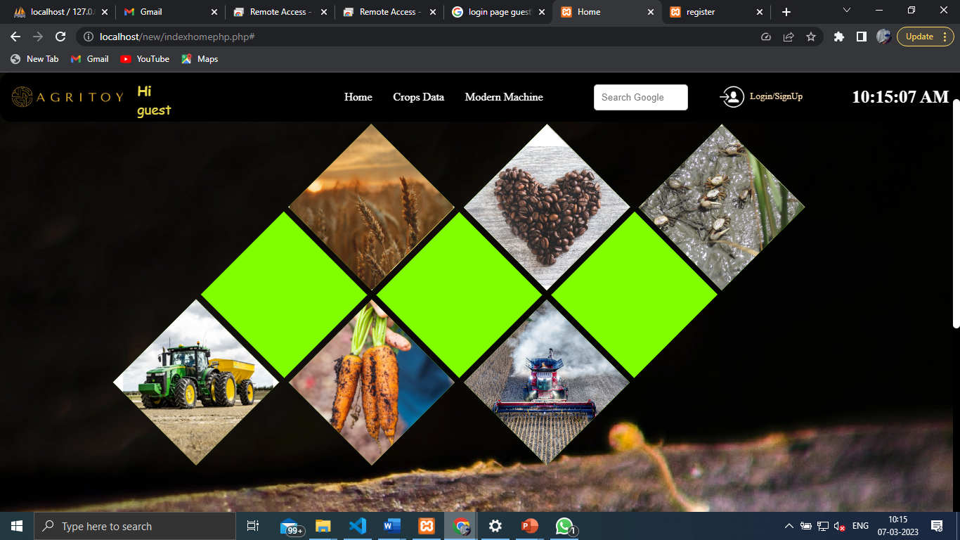

Slide 8
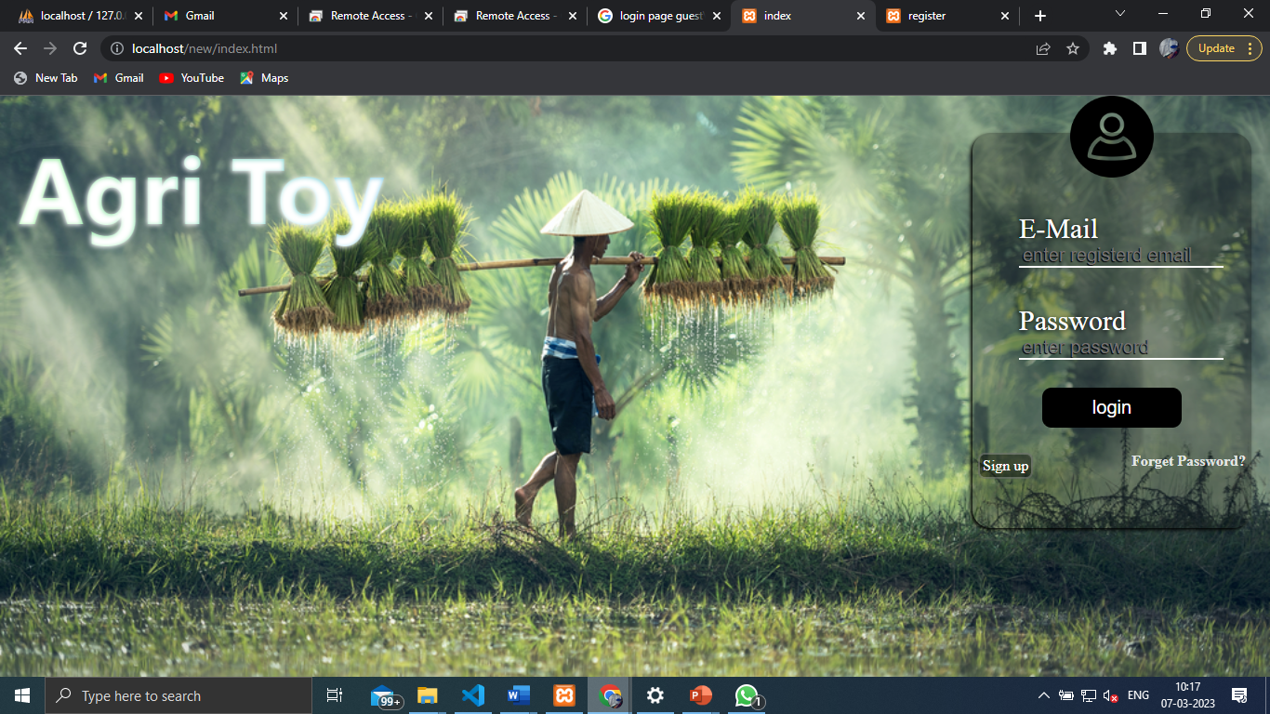

Slide 9
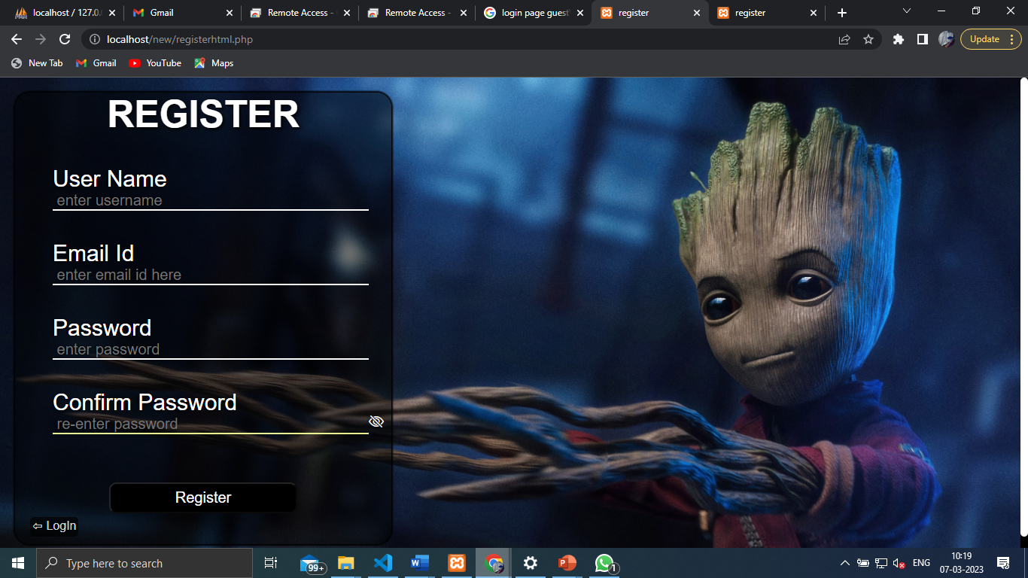

Slide 10
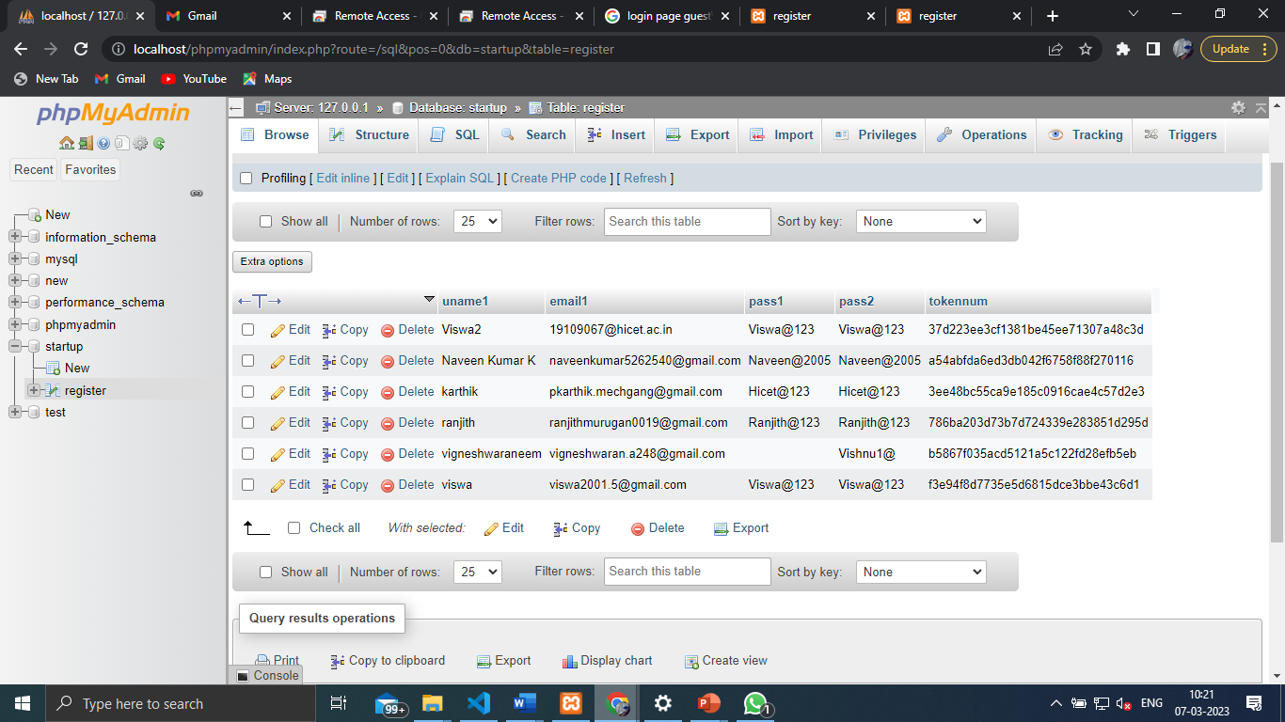
Sensitive content

Slide 11
BUDGET
S.NO | SUB PARTS | PRICE
1 | DOMAN NAME | 699
2 | Standard SSL | 4499
3 | CPanal | 708
4 | GST | 329
5 | Sub Total | 6235
6 | Conference | 503
 | Total | 6738

Slide 12
EXISTING SYSTEM DETAILS
We know about high-tech tractors and computerized farm management, but can Internet home pages really replace the roadside farm stand?
Probably not. But some farmers in California are toying with the idea. A dairy farmer from Tulare, Calif., is experimenting with the Internet as a way to sell his products. Another fellow is thinking of setting up a World Wide Web site to market plants from a citrus nursery.
Jeff Ennen, manager of the Advanced Technology Information Network at California State University at Fresno, has helped such ag interests as the state's Department of Food and Agriculture and the Diamond Walnut company find a place on the Web. "In about another five years," says Mr. Ennen, "I think everyone will be on the Internet in the agriculture industry."
Surely that doesn't mean the local farmer who used to sell apples, peaches, or ears of corn from under an awning-draped shed will soon be glued to a keyboard, trying to close a deal with buyers in Toronto, or wherever. More likely, a lot of people tired of keys and screens will be clustered at his farm stand, eager to buy food the old-fashioned way.

Slide 13
THANK YOU

